Slide 1
School Management
Developed by:
Aleksandr Ponomarev, Bita Jan Feshan, Brian Szubiak, William Paquin

Slide 2
Task 1
Create a page in which teacher can perform multiple(CRUD) operations on a book by connecting it to the database. For example, CRUD for book as create, read, update and delete a book.

Slide 3
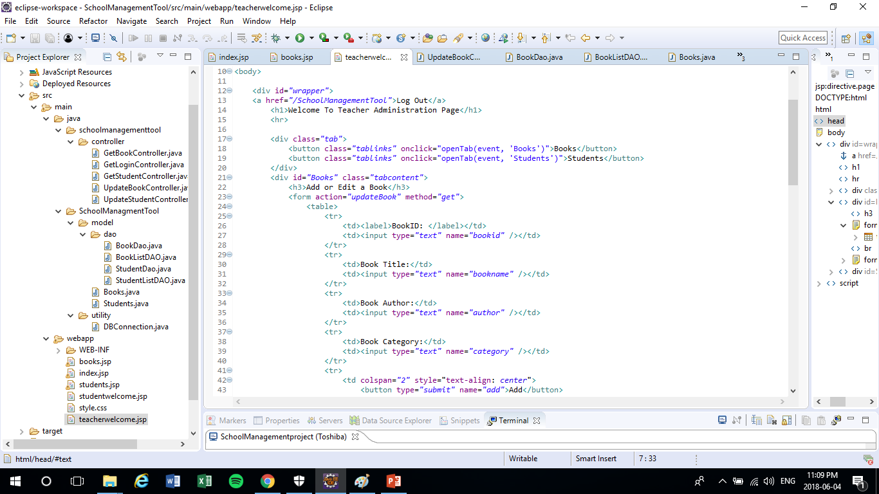

Slide 4
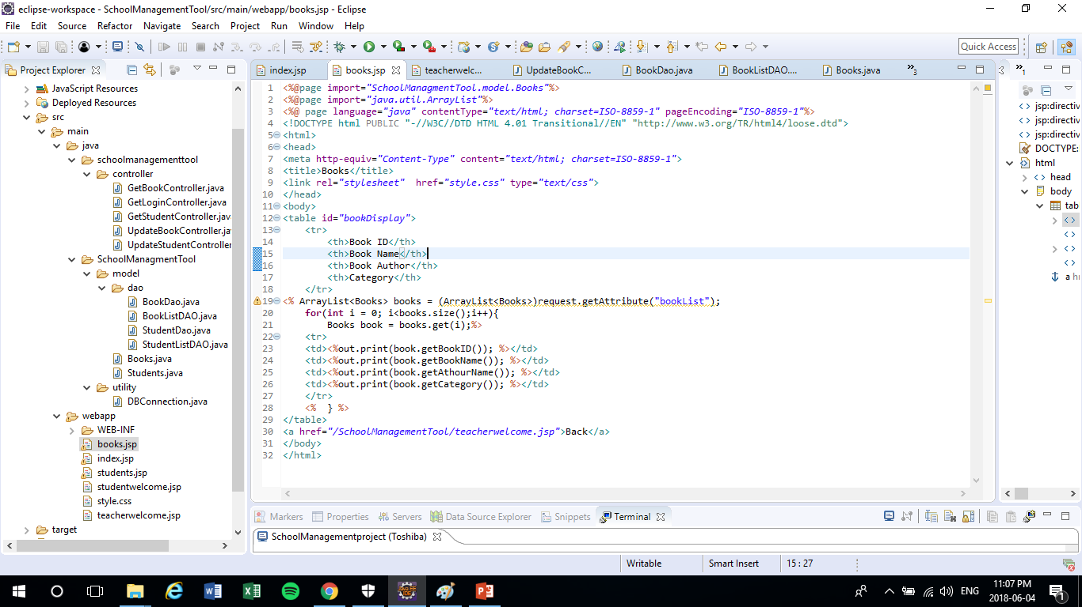

Slide 5
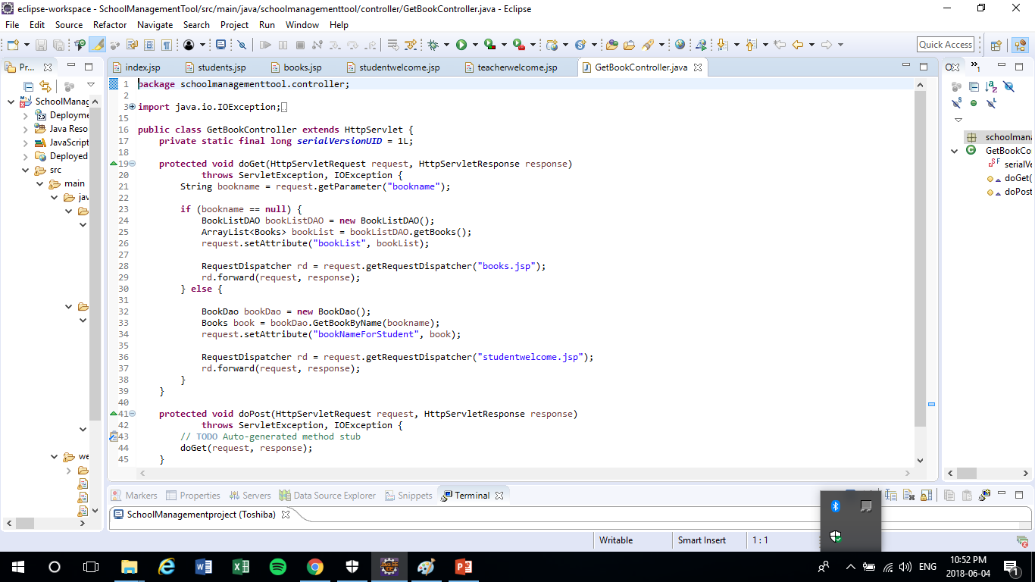

Slide 6
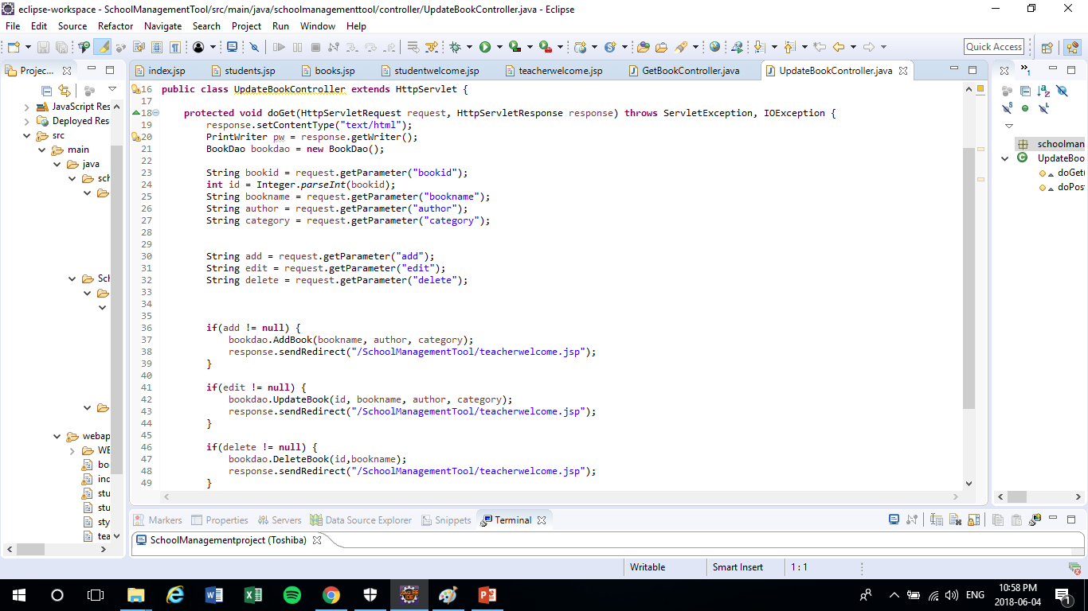

Slide 7
Task 2
Create an inventory page which will show all the items in a table format. (HTML table tags) which will have a table header tag Book ID, Book Name and Book Author.

Slide 9
Task 3
Create a page where teacher can add/read/delete/modify(CRUD) students to the database. Student information stored is studentname, password, first, last name, city and postal code. Similar to the book crud operations

Slide 10
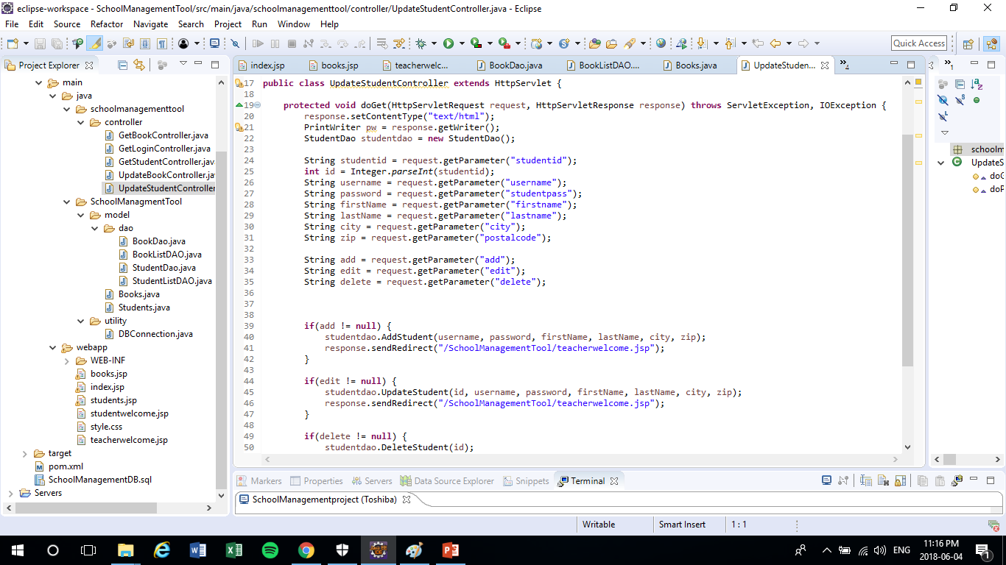

Slide 11
Task 4
Create an inventory page which will show all the items in a table format. (HTML table tags) which will have a table header tag for Student ID, studentname, first and last name combined, city and postal code.

Slide 12
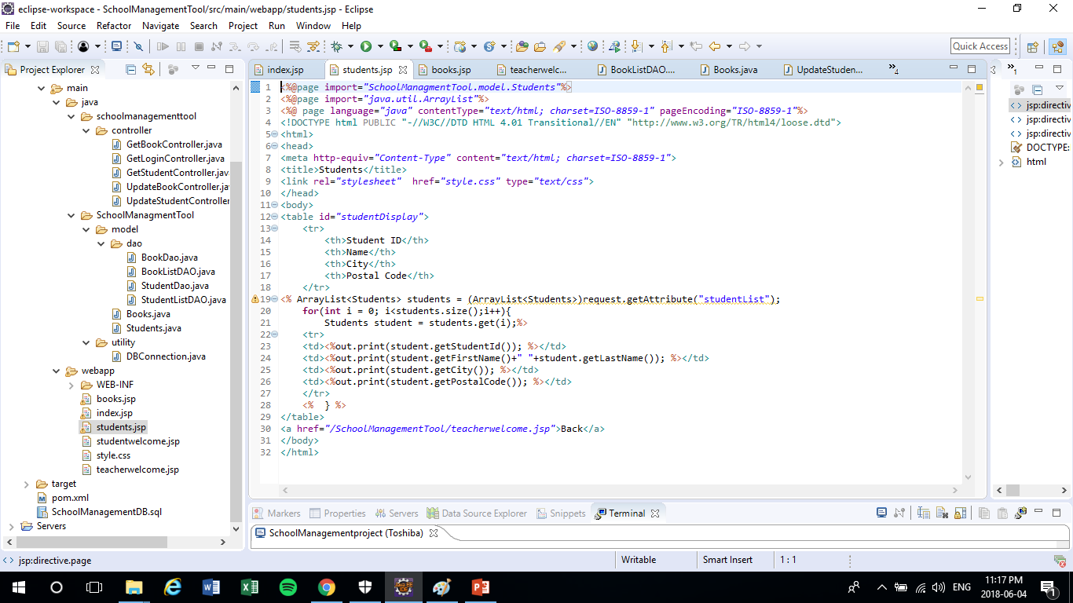

Slide 13
Task 5
Same login page can be used for the student as teacher, but student login should be made successful by validating student information from the database

Slide 15
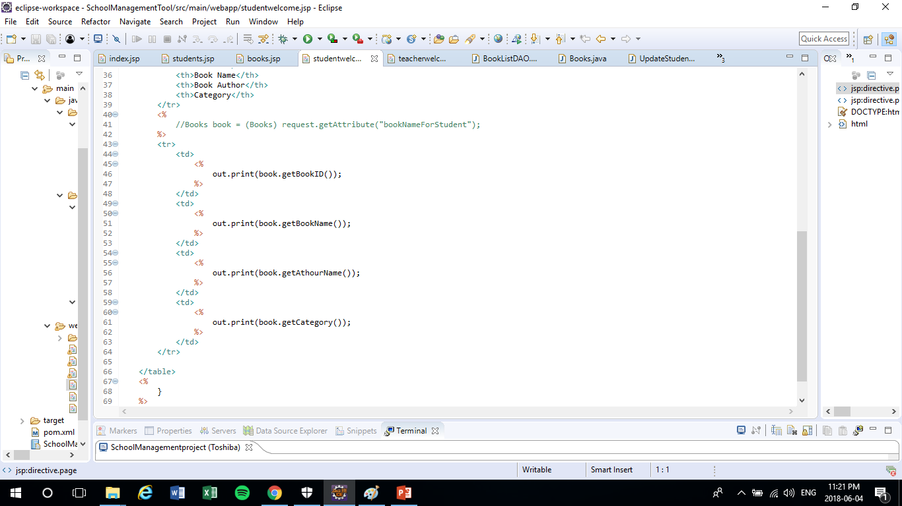

Slide 16
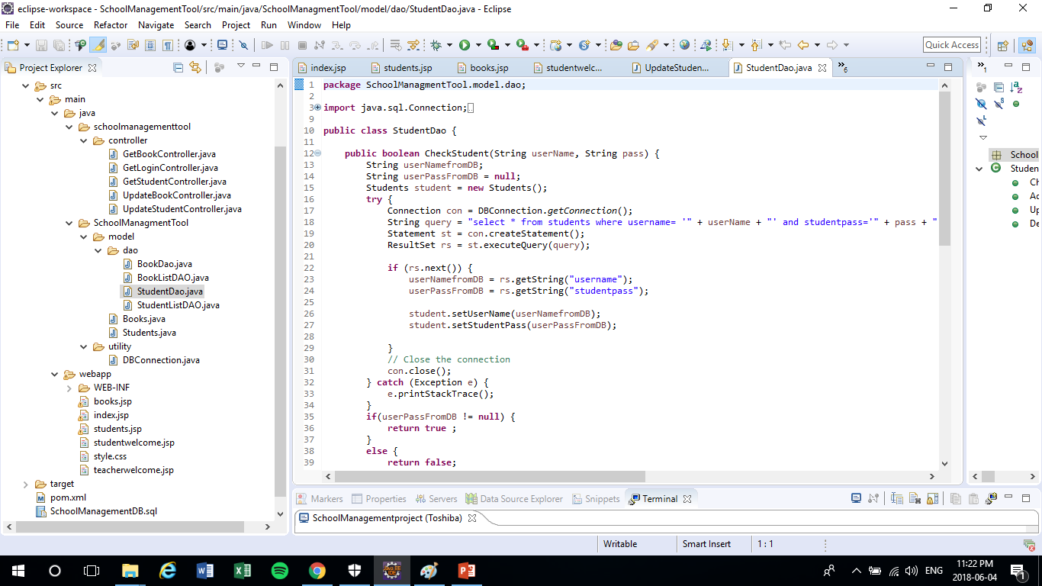

Slide 17
Task 6
Create a page where student search for a book with bookname, if book is present then show the information of the book but if not display error message saying no book found, try again.

Slide 19
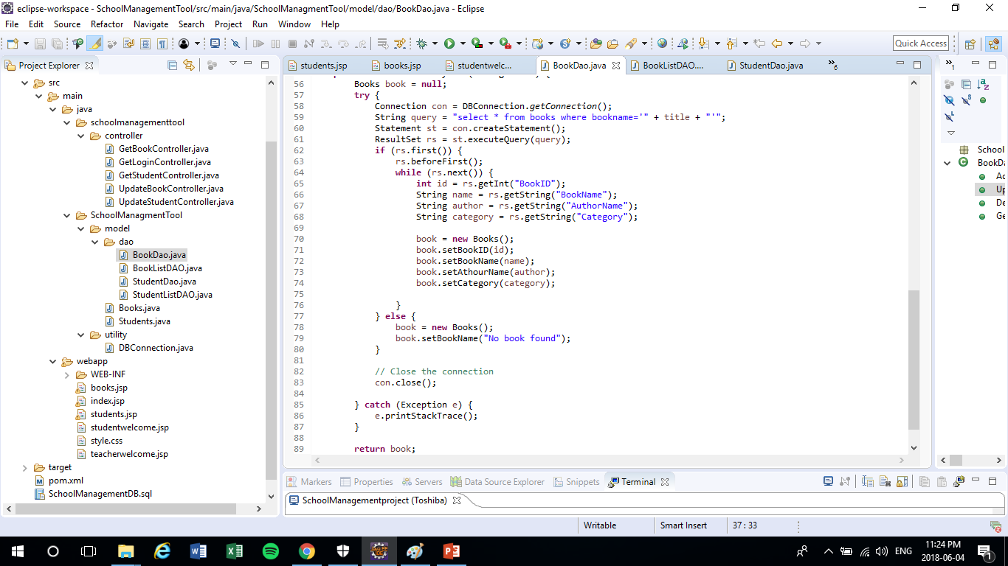

Slide 20
Task 7
Databse: student: create attributes called as studentID (possibly Auto Incremented), studentname, password, firstname, lastname, city, postal code
library: create attributes called as bookID (possibly Auto Incremented), bookname, authorname.

Slide 21
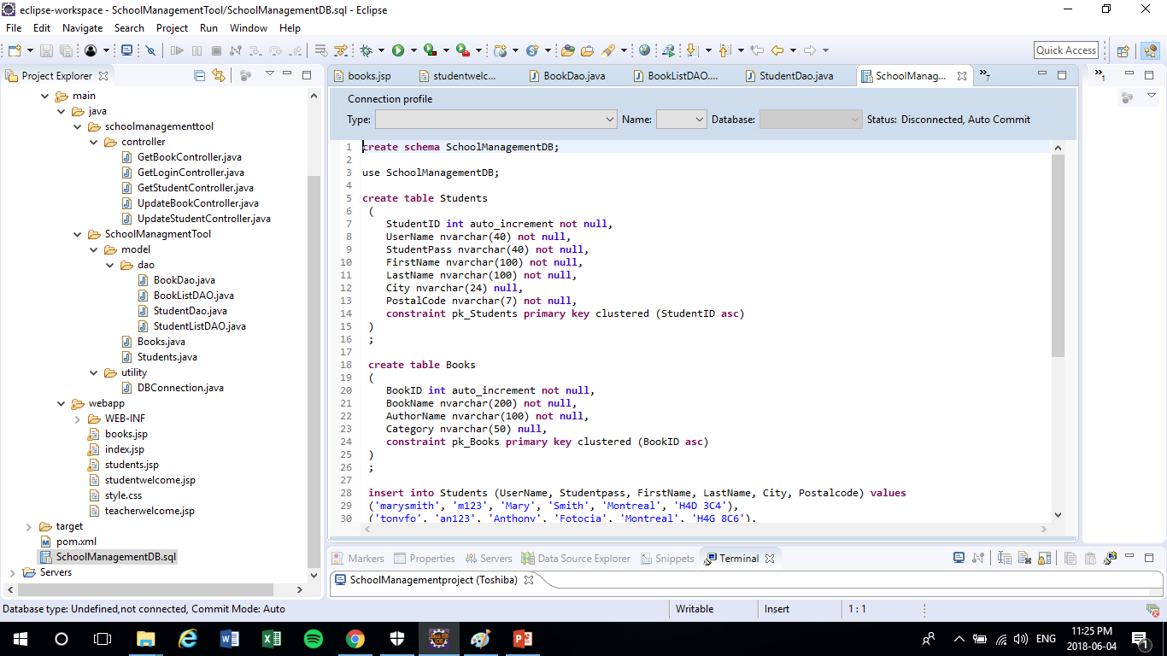

Slide 22
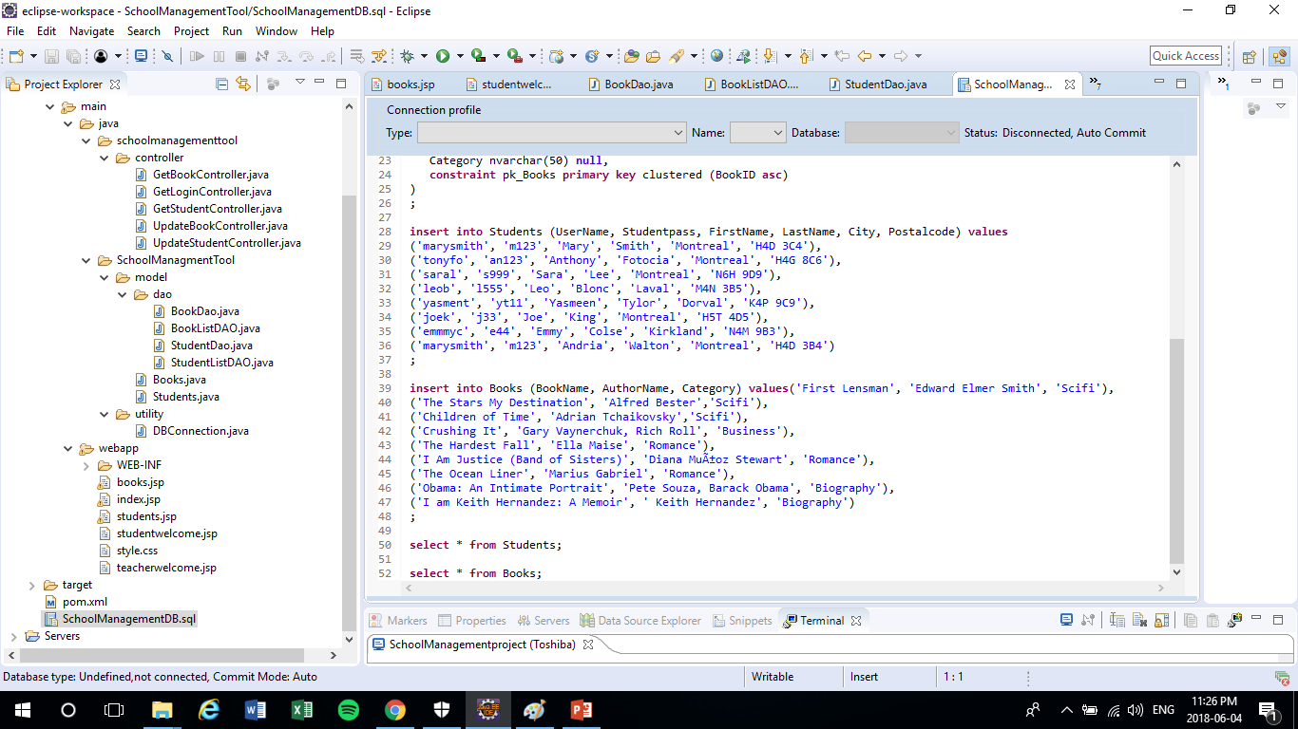

Slide 23


